Slide 1

Basics of electronics engineering
(01ec0101)
Task: Signal generator using NE555 Timer ic
Prepared By:
Karan Rajpara

Slide 2
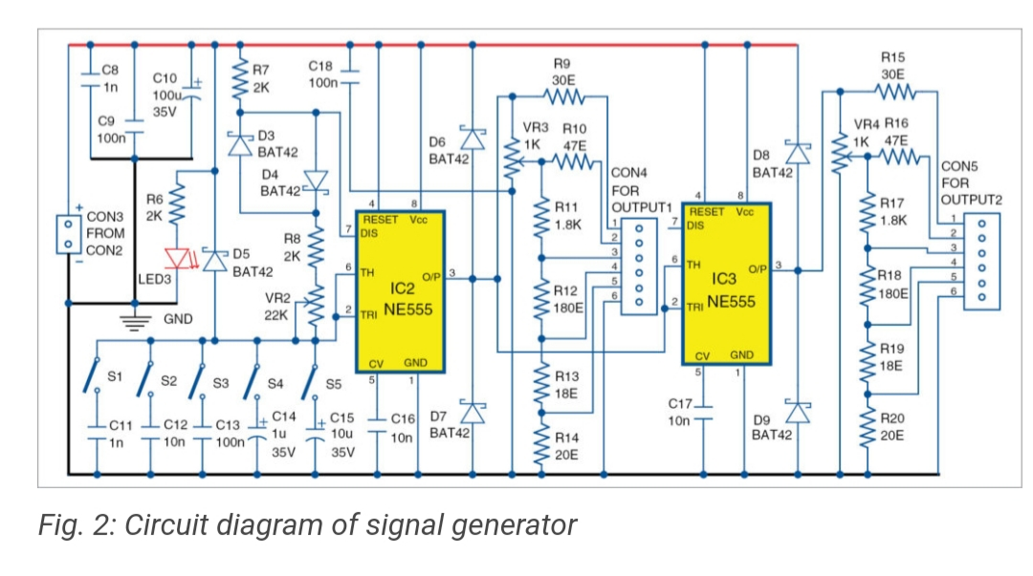
Circuit Diagram of signal Generator

Slide 3
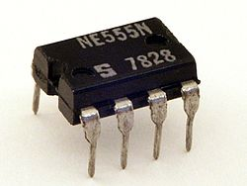
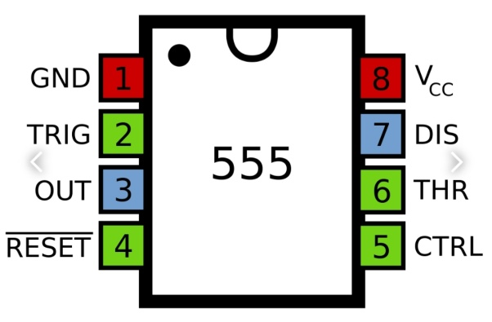
NE555 Timer IC
It can be used in pulse generation and in oscillator and can be use as inverter.
It can be provide time delays and can be use as a flip flop element.

Slide 4
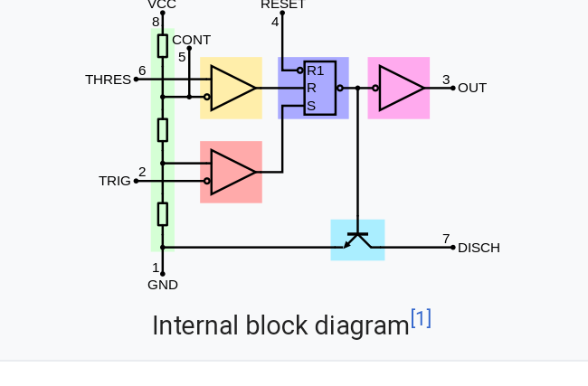

Slide 5
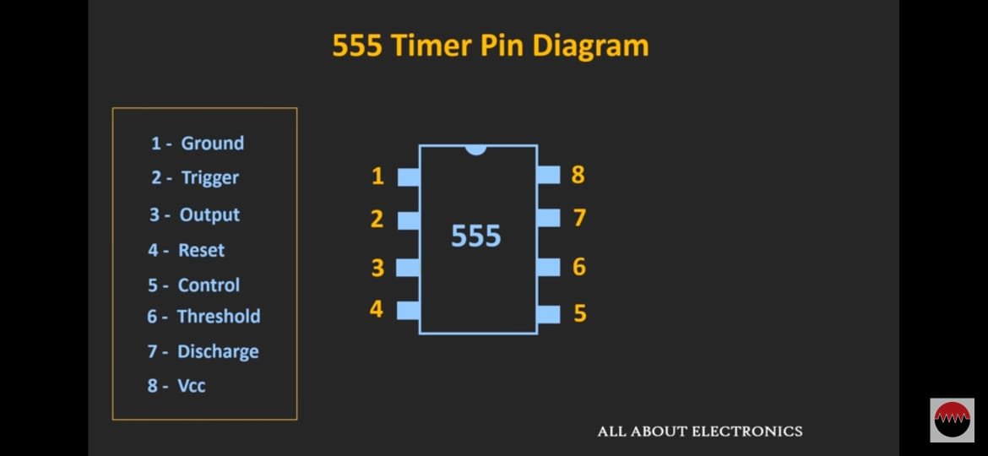

Slide 6
Modes of 555 timer IC:
There are total 3 modes depending upon configuration of external capacitors and resistors to operate 555 timer IC.
Astable Mode
Monostable Mode
Bistable Mode

Slide 7
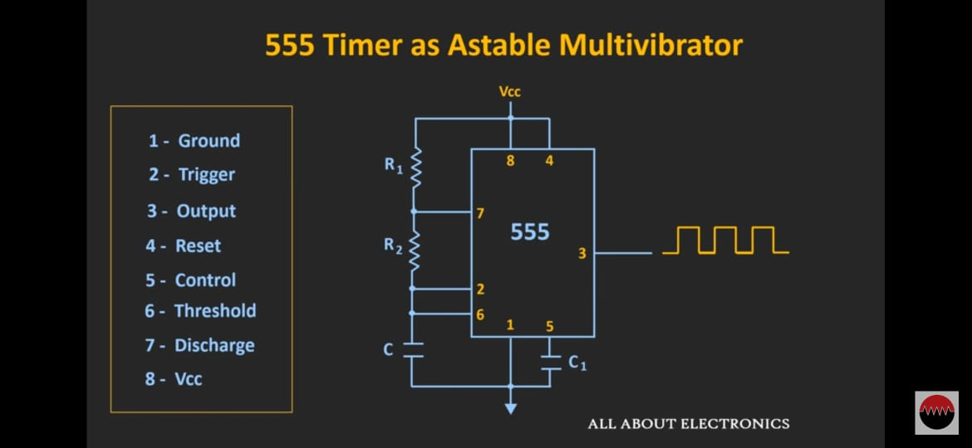

Slide 8
Function of Astable Configuration
In Astable configuration 555 timer IC generates continuous pulse having a specific frequency.
Equation of frequency generated by Astable Mode:
F=1.44/(R1+2R2)*c

Slide 9
Let’s Go to the simulation

Slide 10
Output Frequency: F=1/{0.7*(R2+R3+2*Vr2)Cx}
For example:
When switch s1 is closed Cx=1nF and Vr2=22k ohm. We get minimum frequency.
Fmin=1/{0.7*(2k+2k+2*22k)*1nf}
Fmin=29.7 kHz approx.
When switch s1 is closed and Cx=1nf and Vr2=0 ohm we get maximum frequency.
Fmax=1/{0.7*(2k+2k)*1nF}
Fmax=357 kHz approx.

Slide 11
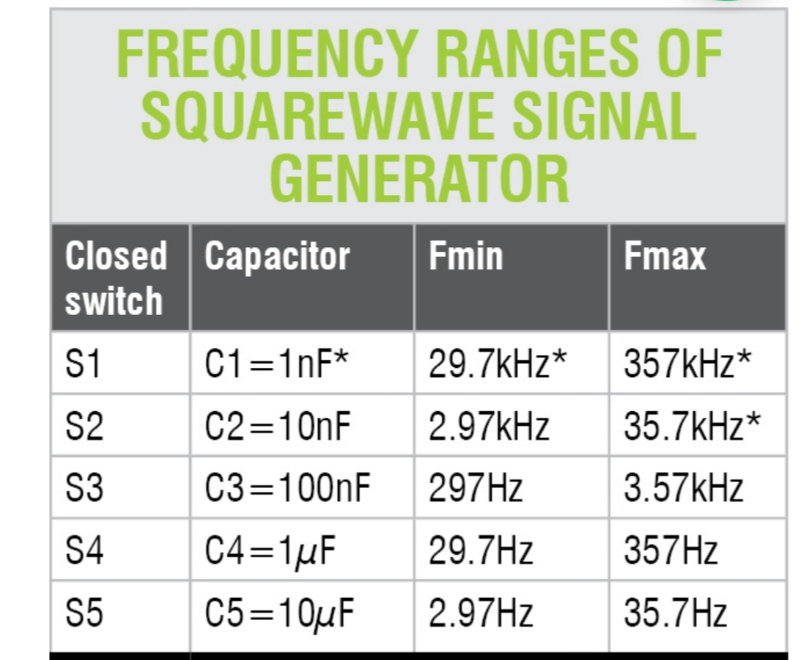

Slide 12
Acknowledgement:
Guided By :
C.D. Parmar Sir (HOD – ICT Department)
Project Link :
https://electronicsforu.com/electronics-projects/signal-generator-inverter-ne555
You tube channel :
All about electronics

Slide 13
Learning Outcome:
Troubleshooting of my circuit
Working of NE555 Timer IC
Different Modes of 555 timer IC
Designing of frequency generator

Slide 14


